Slide 1
1. ការណែនាំអំពី​ Java
[Khmer OS Battambang: 30 Bold]
final keyword ប្រើសម្រាប់ឮធ្វើការ restrict user ។
Final variable
Final method
Final class
[Khmer OS Battambang: 22]

Slide 2
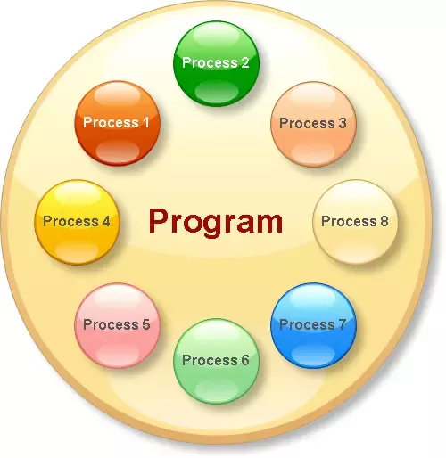
Program
What Is A Program?
Program គឺជា executable file ដែលមានផ្ទុកបណ្ដុំនៃ instructions ដែលសរសេរដើម្បី perform specific task. ឧទាហរណ៍ឮchrome.exe, notepad.exe ។​

Slide 3
Process
អ្វីទៅជា Process?
Process គឺជា executing instance របស់ program​ ។ Process របស់វាសំដៅទៅលើ active entity ដែលវានៅលើ primary memory នឹងចាកចេញពី memory ប្រសិនបើ system ធ្វើការ reboot. យើងអាចធ្វើការបើកកម្មវិធីបានច្រើន Process នៅក្នុងពេលតែមួយ ។
[Khmer OS Battambang: 24]

Slide 4
Thread
អ្វីទៅជា Thread?
Thread គឺជាផ្នែកដ៏តូចមួយរបស់ process. ឧទាហរណ៍, នៅពេលយើងបើក notepad program, operating system បានបង្កើត process មួយ និង ចាប់ផ្ដើម execution main thread របស់ process​នោះ. threads នៅក្នុង processតែមួយគឺ share the same memory, communication រវាងthreads គឺលឿន.

Slide 5
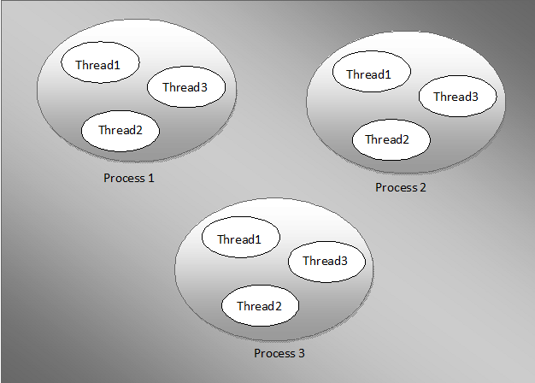
Process​ & Threads

Slide 6
Process vs Threads
Process | Thread
heavy weight operations | light weight operations
has its own memory space. | use the memory of the process they belong to.
Inter process communication is slow as processes have different memory address. | Inter thread communication is fast as threads of the same process share the same memory address of the process they belong to.
Context switching between the process is more expensive. | Context switching between threads of the same process is less expensive.
Processes don’t share the memory with other processes. | Threads share the memory with other threads of the same process.

Slide 7
10. ប្រភពឯកសារ
http://javaconceptoftheday.com/differences-between-program-vs-process-vs-threads/

Slide 8
សូមអរគុណ!!!

